Slide 1
Grocery store recommender
Applied Data Science Capstone
IBM Data Science Professional Certificate
Nupur Jha

Slide 2
Part 1. Problem Description
I am a new Grocery store contractor in Toronto and would like to setup my grocery store in the areas which are crowded, has most liked venues. This will help me to setup my store where people will walk in more and would be ready to buy grocery for their home on regular basis.

Slide 3
Part 2. Data I need
I would need geo-locational information about Toronto borough and its neighborhoods which included its latitude and longitude values.
I will need data about different venues in different neighborhoods of Toronto. In order to gain that information I will use "Foursquare" locational information. For example there is a venue in one of the neighborhoods. As basic information, we can obtain its precise latitude and longitude and also its distance from the center of the neighborhood. But we are looking for advanced information such as the category of that venue and whether this venue is a popular one in its category or total liking is greater than average of this venue.

Slide 4
Part 3. Methodology
Data Cleaning
Finding Neighborhoods inside "Toronto"
Retrieving Locational Data from Foursquare for Each Venue in Every Neighborhood
Data Processing and DataFrome creation for All the Venues inside the Toronto
Machine Learning Techniques (K-Means Clustering)
Results

Slide 5
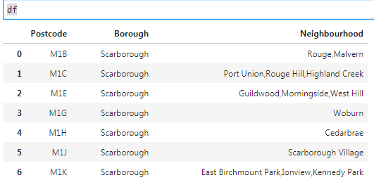
Data Cleaning

Slide 6
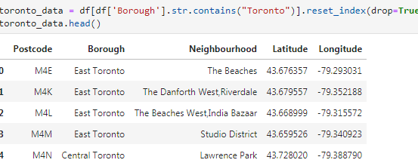
Finding Neighborhood

Slide 7
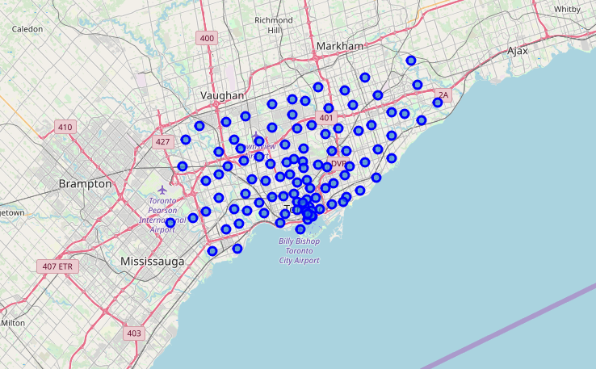
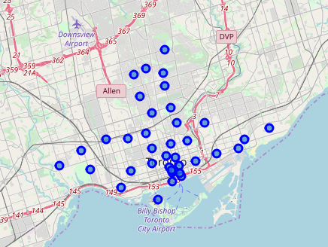
Location Retrival

Slide 8
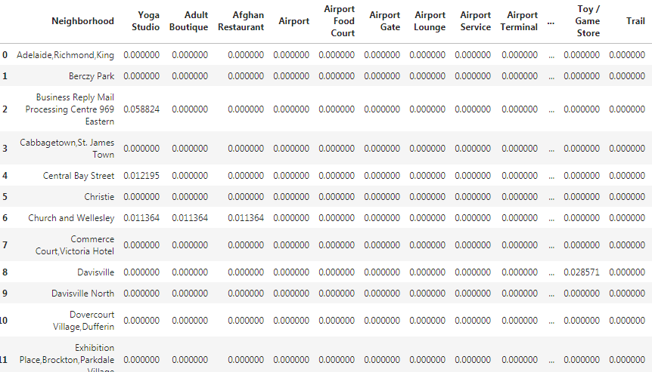
Data Processing and DataFrame creation

Slide 9
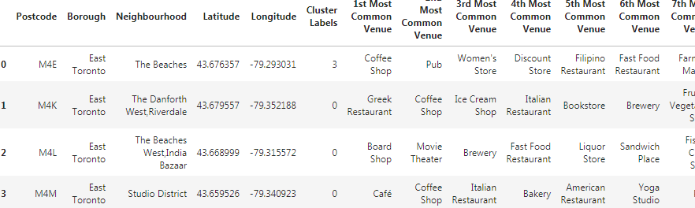
K-Means Clustering

Slide 10
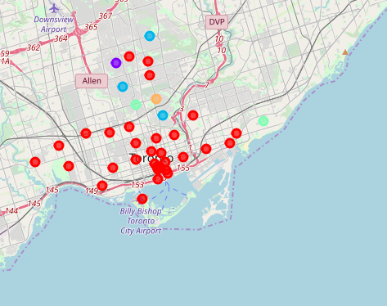
K-Means Clustering

Slide 11
Thank You

